Slide 1
Android Development Community (ADC)
Session 2
google.com/+JupiterTecson
https://github.com/jupiterhub

Slide 2
Topics
Now
Android Version Share
Action Bar (Theory)
Hands On (Action Bar, Up, Styling)
Next
Learn from the best
App Sharing
App Lessons

Slide 3
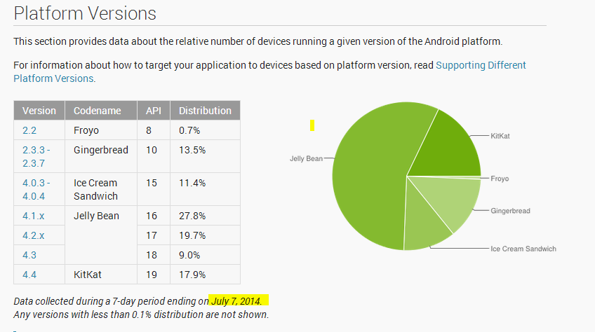
Version Share
https://developer.android.com/about/dashboards/index.html

Slide 4
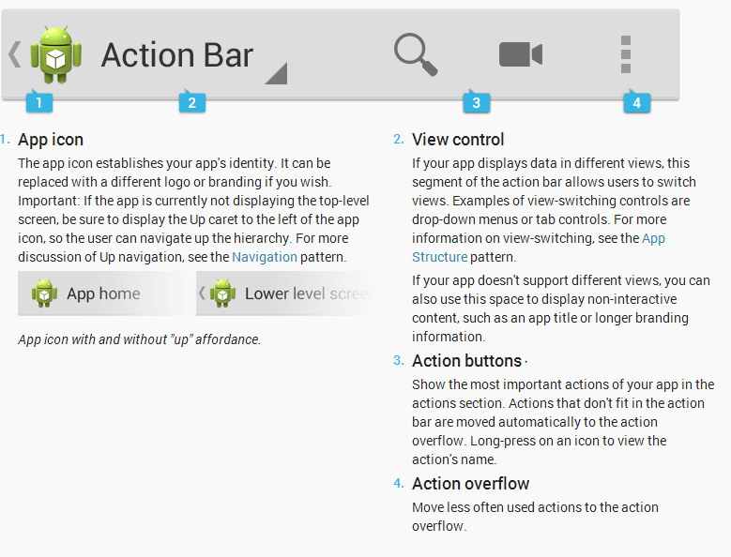
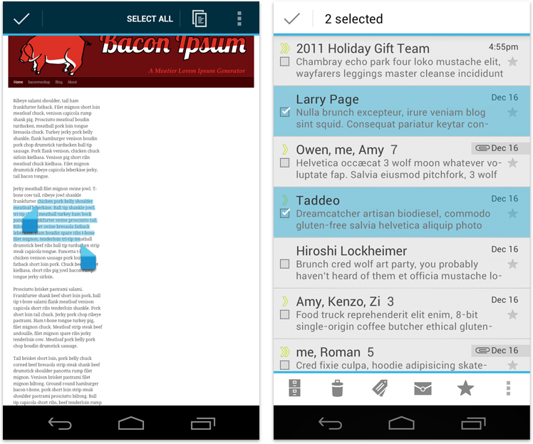
Action Bar - Components
https://developer.android.com/design/patterns/actionbar.html

Slide 5
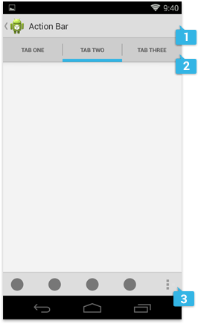
Action Bar - Locations
1. Main Action Bar
2. Top Action Bar
3. Bottom Action Bar
https://developer.android.com/design/patterns/actionbar.html

Slide 6
Action Bar - Contextual
https://developer.android.com/design/patterns/actionbar.html

Slide 7
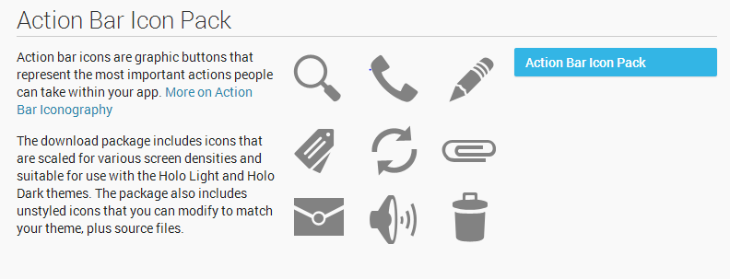
Action Bar - Icon Pack
Download - https://developer.android.com/design/downloads/index.html

Slide 8
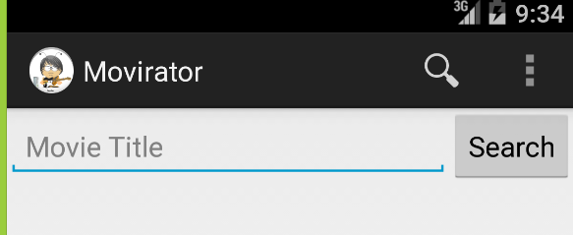
Action Bar - Hands on
Add Actions
Handle Action - https://developer.android.com/reference/android/app/Activity.html#onOptionsItemSelected(android.view.MenuItem)

Slide 9
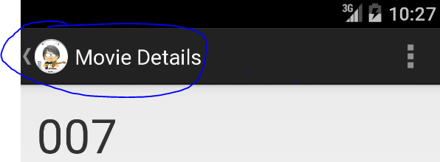
Action Bar - Hands on
Up Navigation
Handling Up

Slide 10
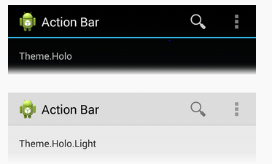
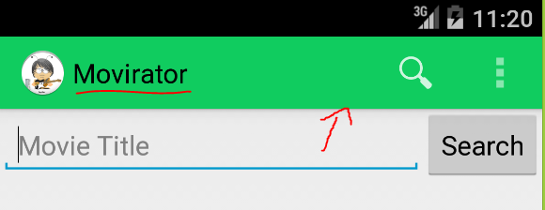
Action Bar - Hands-on
Theming Text
Theming Background
props: https://developer.android.com/guide/topics/ui/actionbar.html#Style
https://developer.android.com/training/basics/actionbar/styling.html

Slide 11
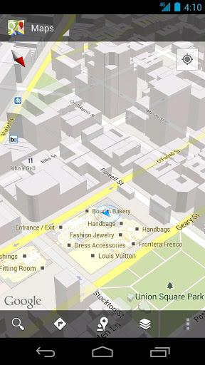
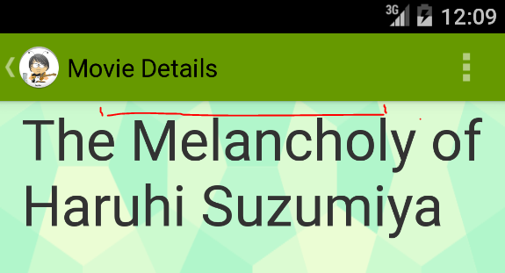
Action Bar - Hands-on
Overlay
Top Margin (Padding)
Background: http://subtlepatterns.com/
https://developer.android.com/training/basics/actionbar/overlaying.html

Slide 12
Topics
Now
Android Version Share
Action Bar (Theory)
Hands On (Action Bar, Up, Styling)
Next
Learn from the best
App Sharing
App Lessons

Slide 13
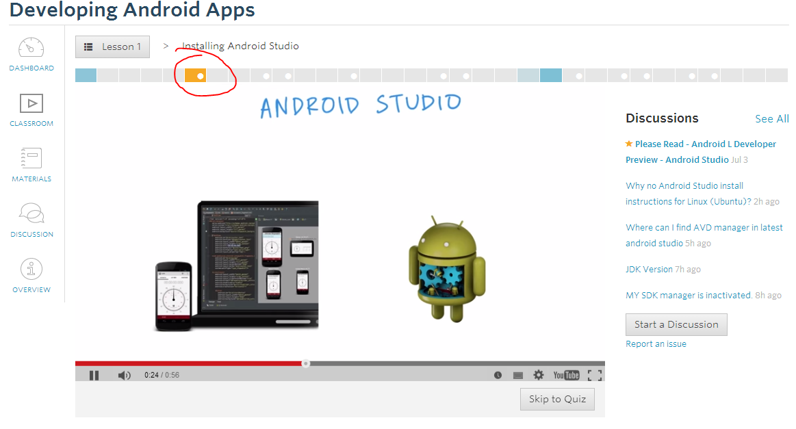
Learn from the best
https://www.udacity.com/course/ud853

Slide 14
Next - App Sharing
Api usage? Challenge? Suggestions?
Anyone who wants to share

